Slide 1
Some Highlights of ICLR 2020
Presenter: Gwenaelle Cunha Sergio
Artificial Brain Research Lab., School of Electronics Engineering, Kyungpook National University
14-May-2020

Slide 2
BERTScore: Evaluating Text Generation with BERT Tianyi Zhang et al. (Cornell Uni, ASAPP Inc) Code (PyTorch): https://github.com/Tiiiger/bert_score
Notes:
Code (PyTorch): https://github.com/Tiiiger/bert_score

Slide 3
Evaluation metrics
N-gram:
BLEU (Papineni et al., 2002)
METEOR (Banerjee and Lavie, 2005)
ROUGE (Lin, 2004)
chrF (Popovic, 2015)
Embedding-based:
Meant 2.0 (Lo, 2017)
YiSi (Lo et al., 2018)
Proposed: new evaluation metric that uses BERT embeddings
Higher n:
+ Better able to capture word order
- Becomes more restrictive and constrained to the exact form of the reference.
“Analogously to common metrics, BERTScore computes a similarity score for each token in the candidate sentence with each token in the reference sentence. However, instead of exact matches, we compute token similarity using contextual embeddings.“
- Not restricted to a maximum n-gram
- Allows for relaxed matches (like METEOR)
- Support available for 104 languages
- Task agnostic: not optimized for any specific evaluation task

Slide 4
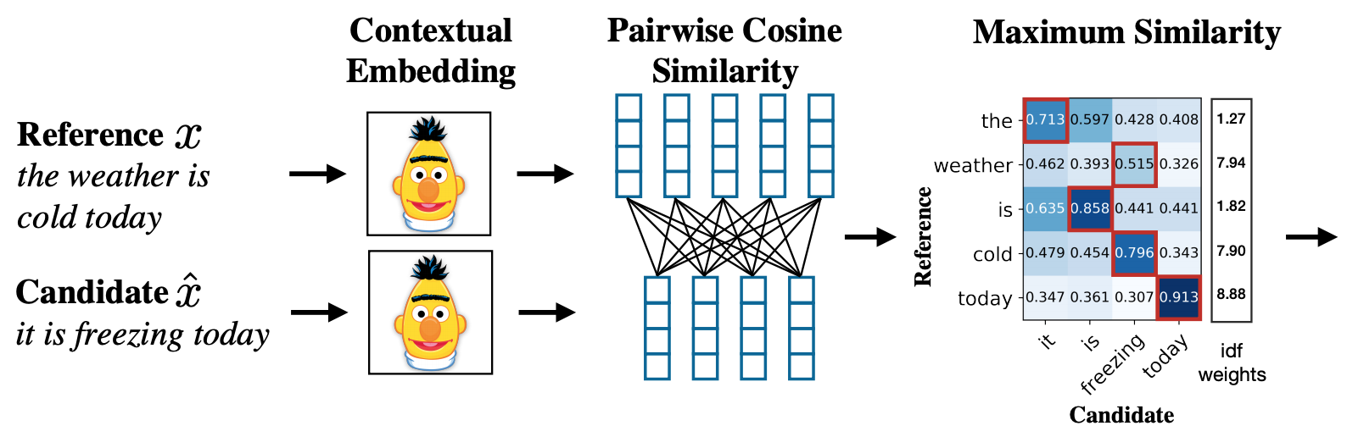
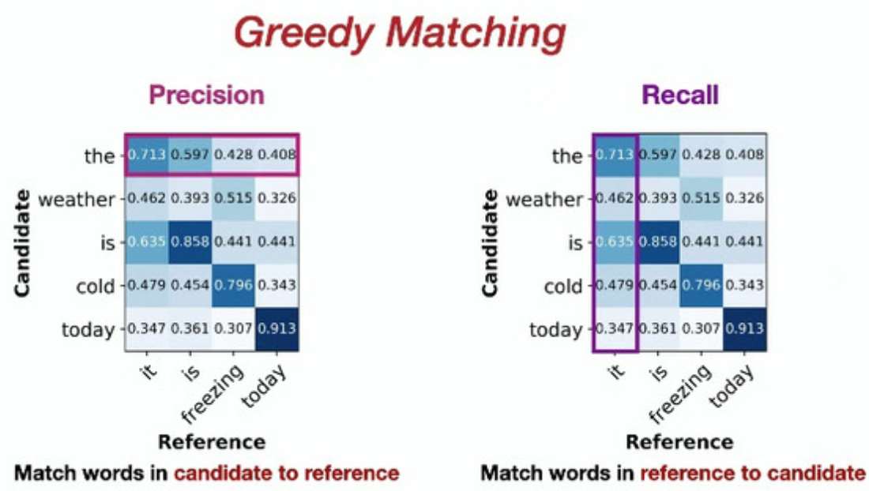
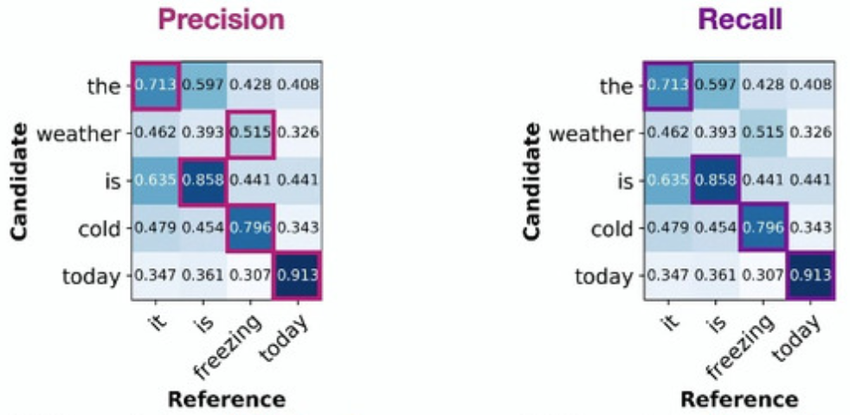
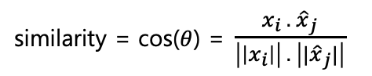
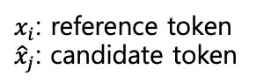
Proposed Model
row
max value
column
similarity = cos($θ$) = $\frac{x_{i} . {\hat{x}}_{j}}{\left|\left|x_{i}\right|\right| . \left||{\hat{x}}_{j}|\right|}$
$x_{i}$: reference token
${\hat{x}}_{j}$: candidate token

Slide 5
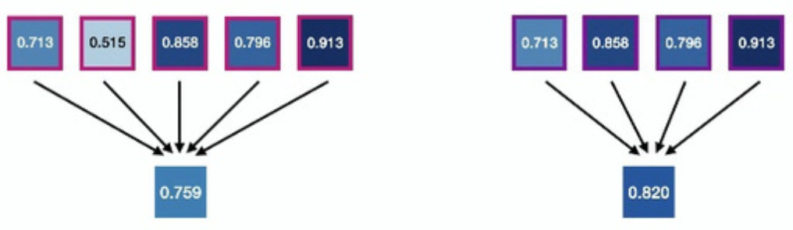
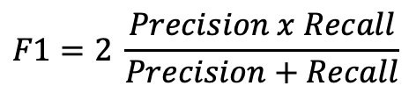
Proposed Model
mean
$$F1=2 \frac{Precision x Recall}{Precision+Recall}$$

Slide 6
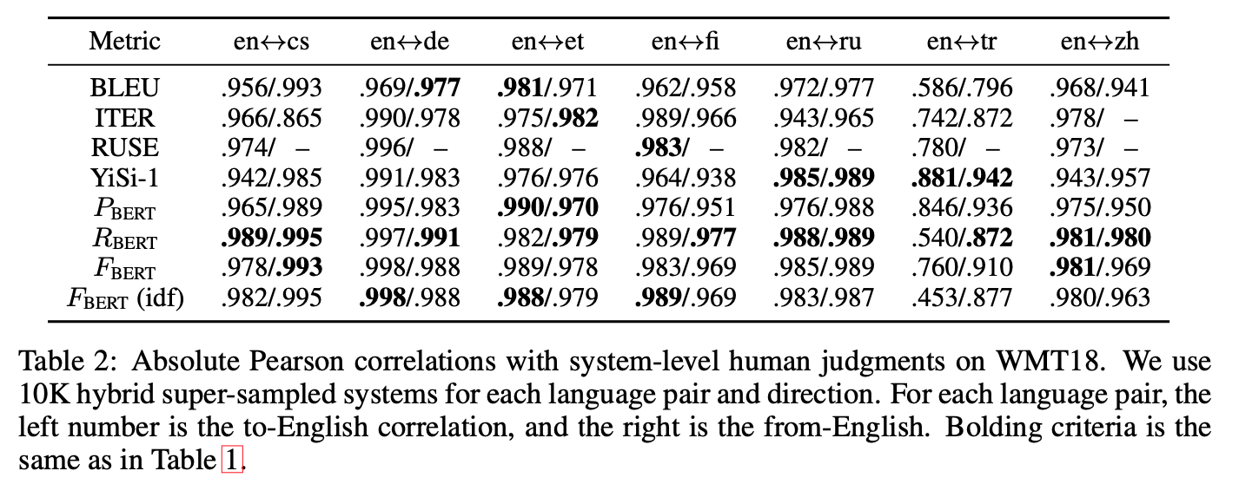
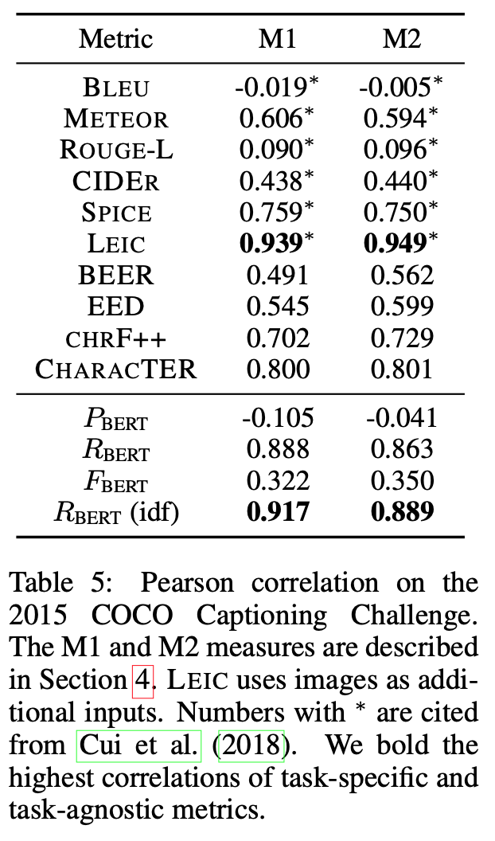
Results
Machine Translation
Significantly higher performance
compared to the other metrics.
Image captioning
Outperforms all task-agnostic baselines by
large margins and correlates better with
human judgments than existing metrics.
Speed
Able to process 192.5 candidate-reference pairs/second using a GTX-1080Ti GPU.
Evaluating the complete WMT18 en-de test set (2,998 sentences):
BERTScore: 15.6 seconds
SacreBLEU: 5.4 seconds

Slide 7
Generalization through Memorization: Nearest Neighbor Language Models Urvashi Khandelwal et al. (Stanford NLP, FAIR) Code: https://github.com/urvashik/knnlm
Notes:
Code: https://github.com/urvashik/knnlm

Slide 8
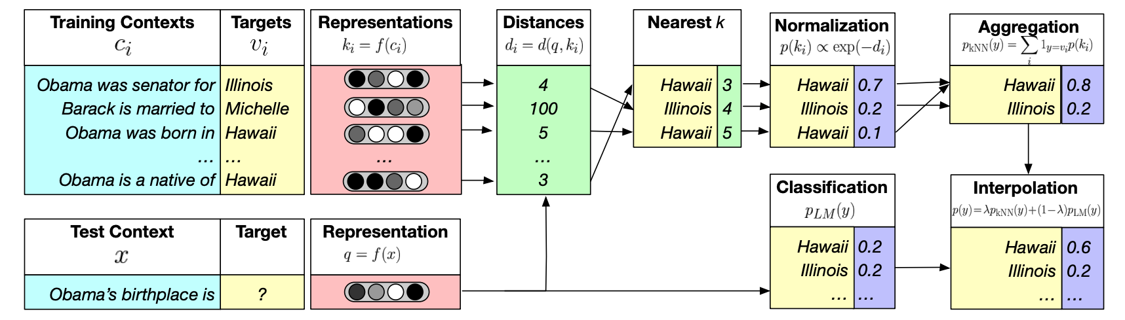
Proposed Model
Motivation
“Instead of adding parameters and training costs, can explicitly memorizing data make LMs generalize better without the added cost of training?”
Proposed
Nearest Neighbor Language Models (kNN-LMs)
Assume there is a network that has been trained with a dataset.
Given a new (bigger) dataset, instead of fine-tuning or retraining the model (high computation cost), use the new data (datastore) to find similar entries in the old data and make more educated predictions.
Similar data pairs from training set using FAISS.
Notes:
Figure 1: An illustration of kNN-LM. A datastore is constructed with an entry for each training set token, and an encoding of its leftward context. For inference, a test context is encoded, and the k most similar training contexts are retrieved from the datastore, along with the corresponding targets. A distribution over targets is computed based on the distance of the corresponding context from the test context. This distribution is then interpolated with the original model’s output distribution.

Slide 9
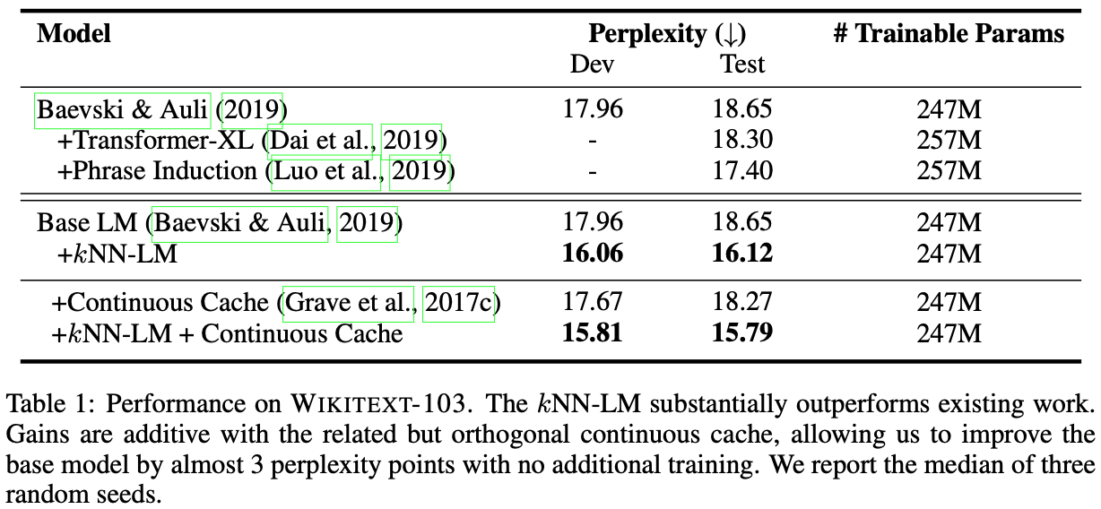
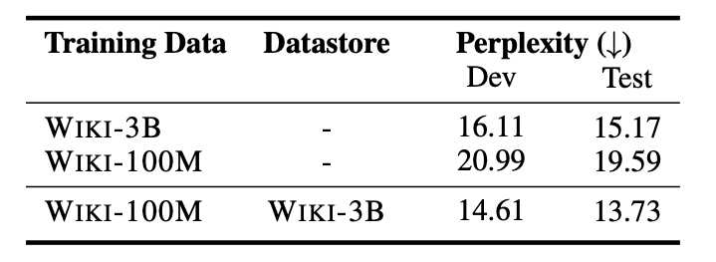
Results
Notes:
Continuous Cache: Model saves and retrieves neighbors from earlier in the test document, rather than the training set.

Slide 10
StructBERT: Incorporating Language Structures into Pre-training for Deep Language Understanding Wei Wang et al. (Alibaba Group) Note: No code, no plan to release

Slide 11
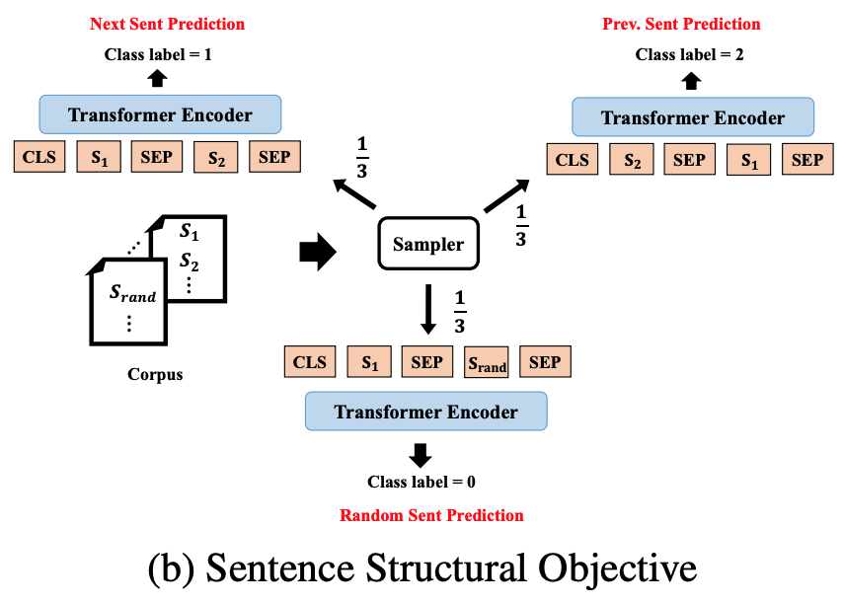
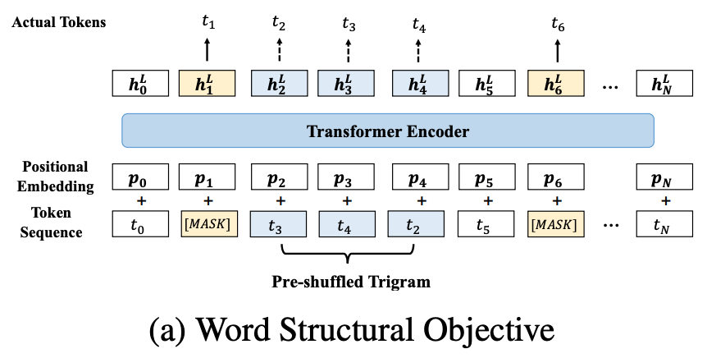
Proposed Model
New pre-training objectives in BERT
Given a set of words in random order from a
sentence, ideally a good language model
should be able to recover this sentence by
reconstructing the correct order of these words.
Extension of the NSP task in the original BERT. StructBERT performs next, previous and random sentence prediction.
Goal: “to make the pre-trained language model aware of the sequential order of the sentences in a bidirectional manner.“

Slide 12
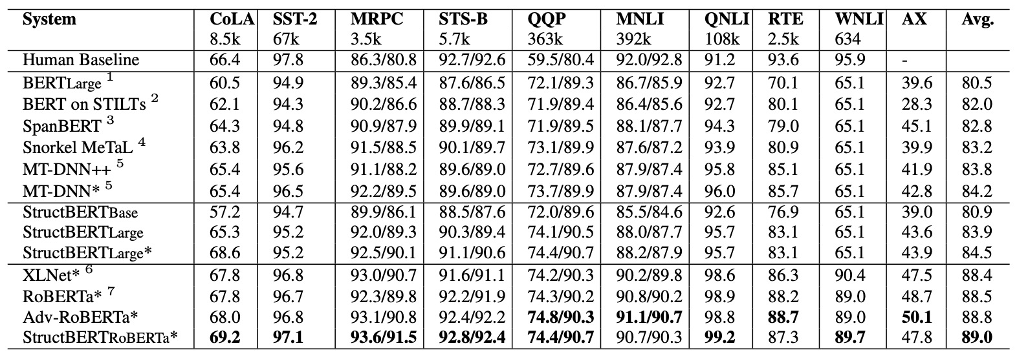
Results
SoTA in GLEU Benchmark
Model was trained on 64 v100 GPUs for about two months (according to author)

Slide 13
ELECTRA: Pre-training Text Encoders as Discriminators Rather Than Generators Kevin Clark, Minh-Thang Luong, Quoc V. Le, Christopher D. Manning (Stanford Uni, Google Brain) Code (Tensorflow): https://github.com/google-research/electra Code (HuggingFace): https://huggingface.co/transformers/model_doc/electra.html
Notes:
Code (Tensorflow): https://github.com/google-research/electra
Code (HuggingFace): https://huggingface.co/transformers/model_doc/electra.html

Slide 14
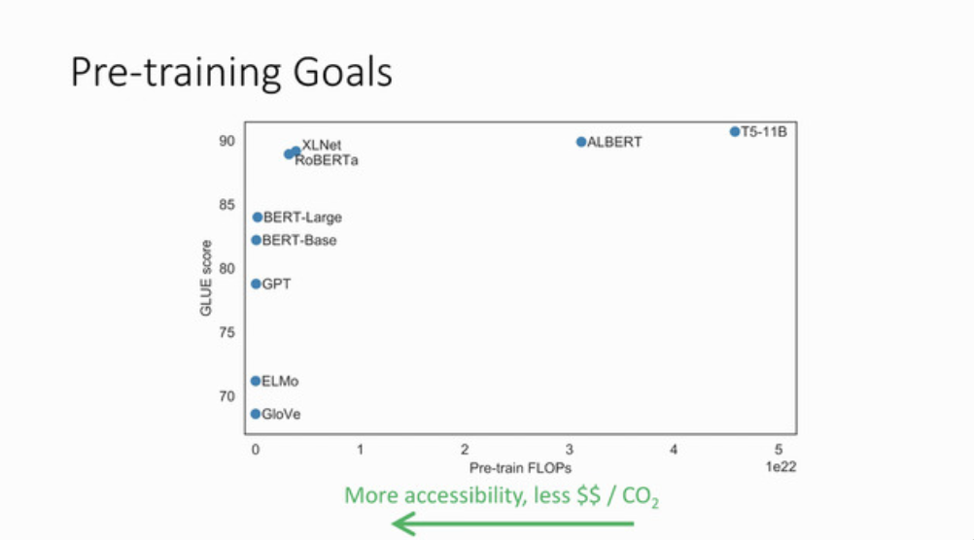
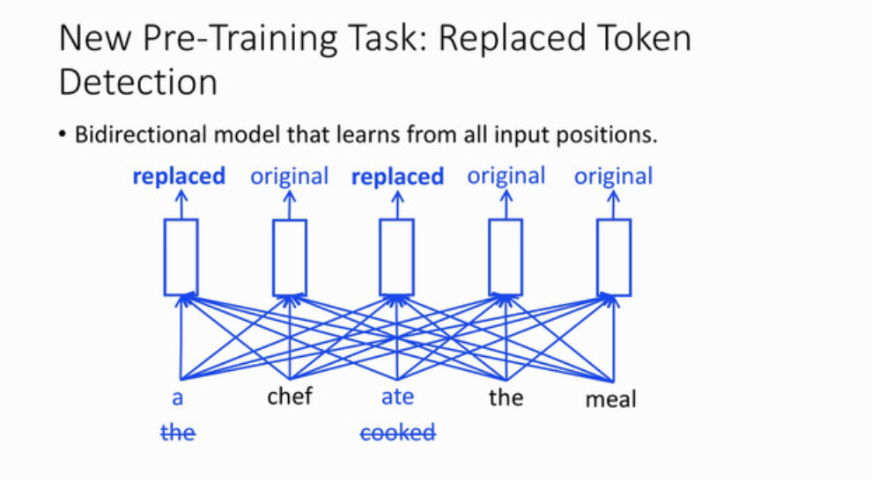
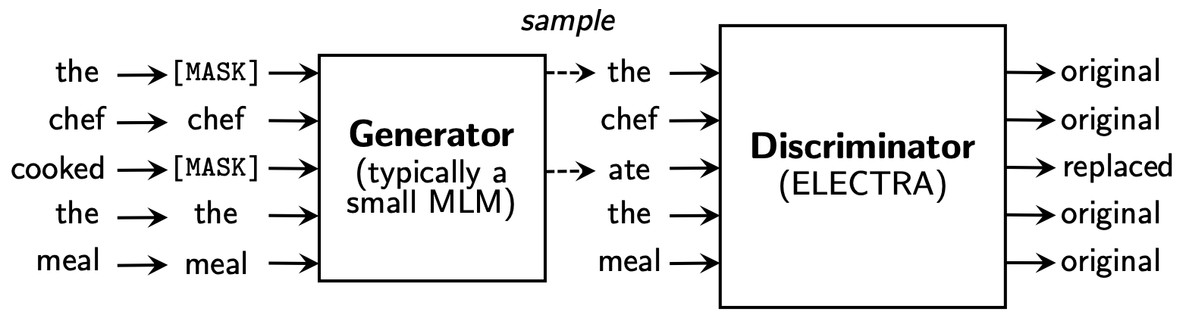
Proposed Model
Motivation:
Make models more green.
Achieve good performance without the need to make the model bigger, more data and more computing power.
Proposed:
New pre-training task: replaced token detection
- Generator is trained together with the ELECTRA model.
- When fine-tuning it for downstream tasks, only ELECTRA is used.
- Advantage over BERT: able to learn from every single input position instead of the 15% only.

Slide 15
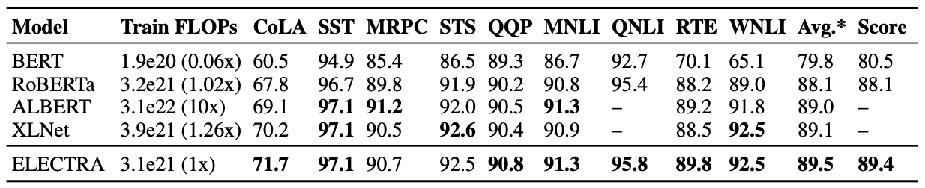
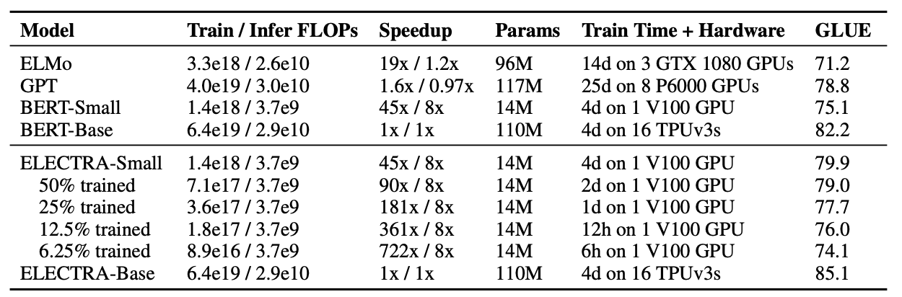
Results
GLUE
* With ensemble, ELECTRA-large
Computing

Slide 16
ALBERT: A Lite BERT for Self-supervised Learning of Language Representations Zhenzhong Lan et al. (Google Research) Code (TF, with pre-trained weights): https://github.com/google-research/ALBERT Code (HugginFace): https://huggingface.co/transformers/model_doc/albert.html
Notes:
Code (TF, with pre-trained weights): https://github.com/google-research/ALBERT
Code (HugginFace): https://huggingface.co/transformers/model_doc/albert.html

Slide 17
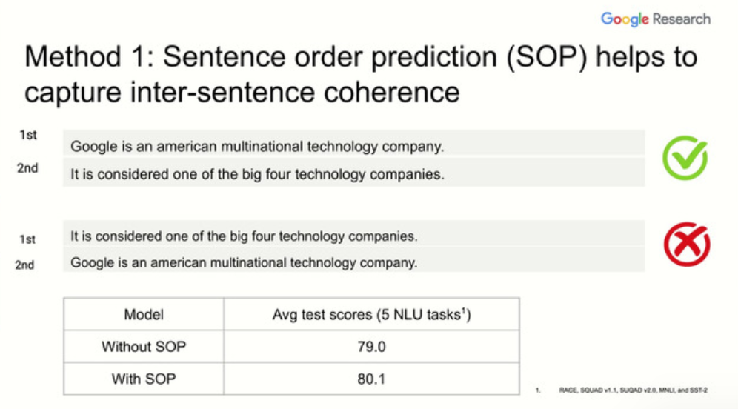
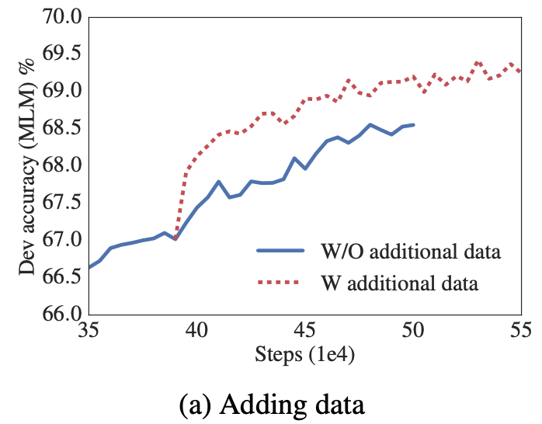
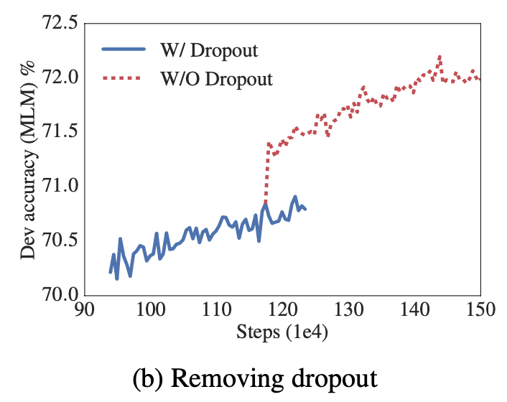
Proposed Model
3 additional pre-training strategies to boost performance:
Sentence Order Prediction (SOP): helps with inter-sentence coherence.
Removes dropout: increases model capacity and reduces memory consumption.
10x more data

Slide 18
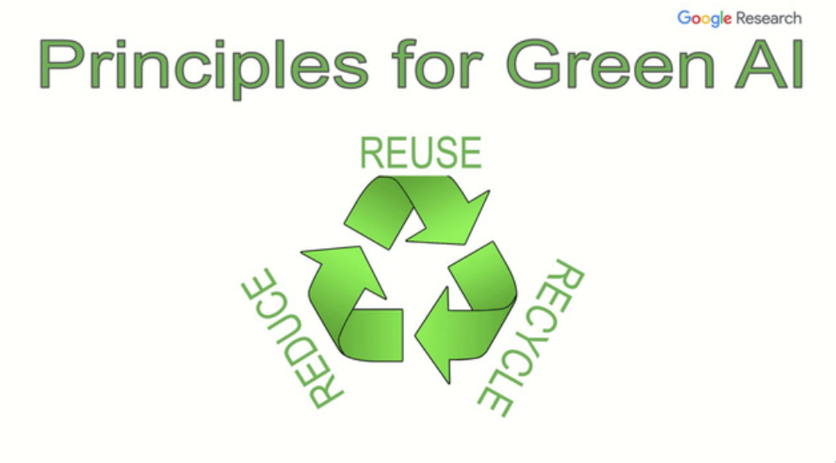
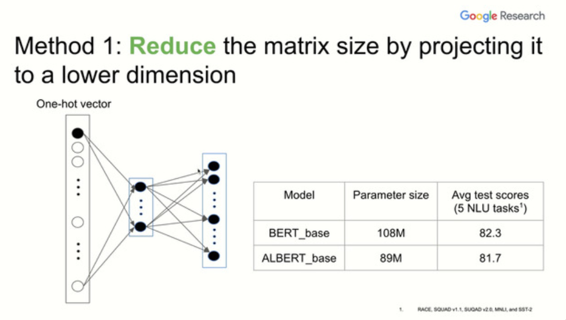
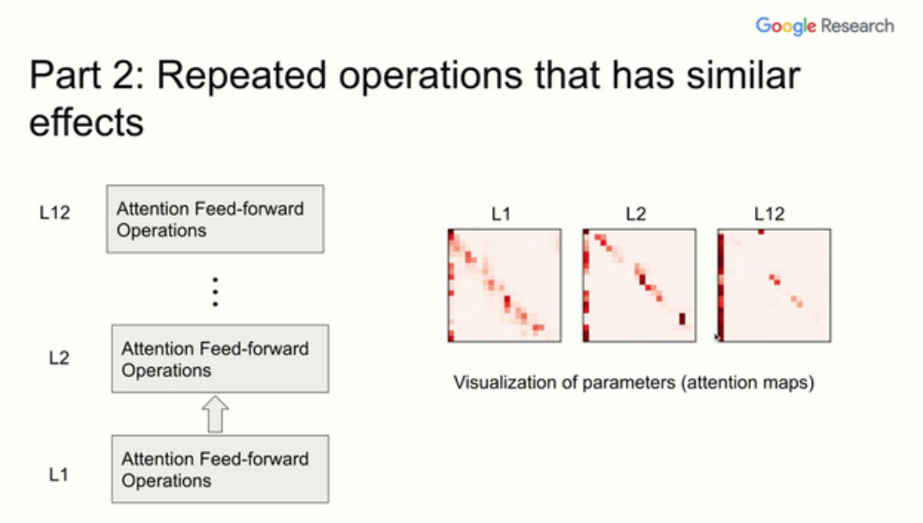
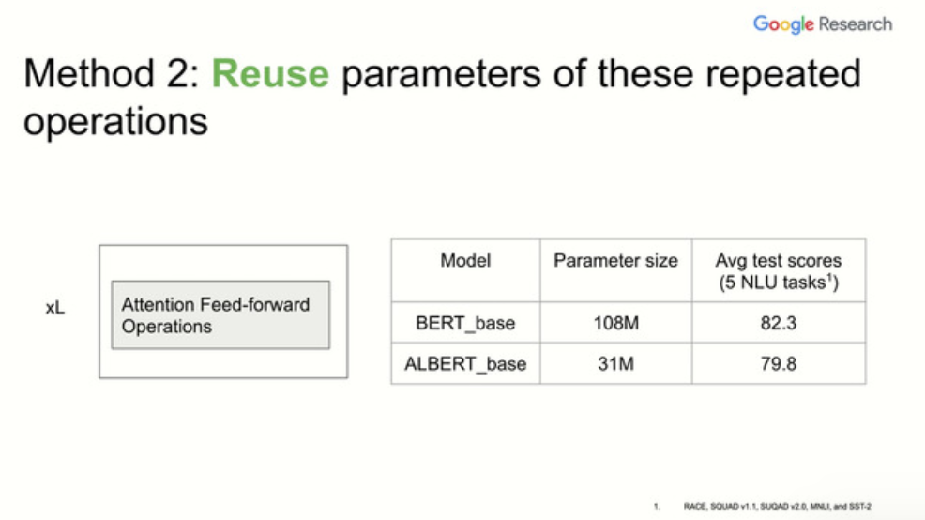
Proposed Model
Reduce parameters by reducing BERT’s embedding dimension (from 768 to 128) and a simple projection layer back to 768 after.
Green AI
Reuse shared weights in Attention Feed Forward Operations layers, resulting in parameter reduction.

Slide 19
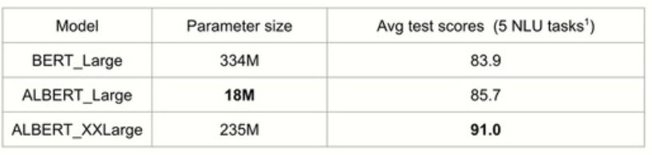
Proposed Model
Reduce parameters by reducing BERT’s embedding dimension (from 768 to 128) and a simple projection layer back to 768 after.
Green AI
Reuse shared weights in Attention Feed Forward Operations layers, resulting in parameter reduction.
Recycle
ALBERT_Large has very few parameters, so in this principle, the author increased the hidden parameters by a lot in ALBERT_XXLarge.

Slide 20
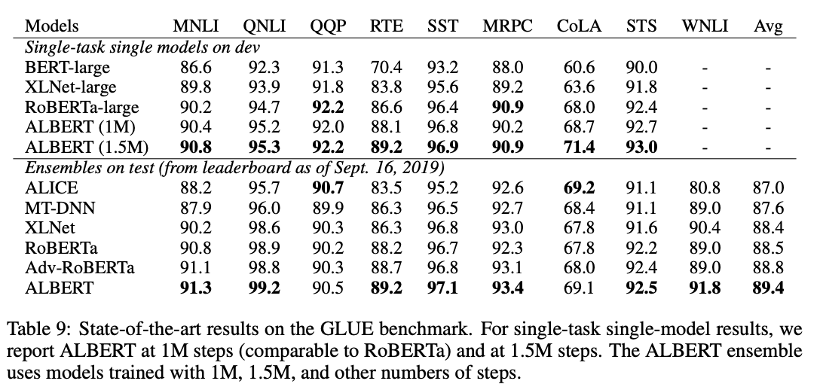
Results

Slide 21
References
Zhang, Tianyi, et al. "Bertscore: Evaluating text generation with bert." arXiv preprint arXiv:1904.09675 (2019). [https://github.com/Tiiiger/bert_score]
Khandelwal, Urvashi, et al. "Generalization through Memorization: Nearest Neighbor Language Models." arXiv preprint arXiv:1911.00172 (2019). [https://github.com/urvashik/knnlm]
Wang, Wei, et al. "StructBERT: Incorporating Language Structures into Pre-training for Deep Language Understanding." arXiv preprint arXiv:1908.04577 (2019). [No code]
Clark, Kevin, et al. "Electra: Pre-training text encoders as discriminators rather than generators." arXiv preprint arXiv:2003.10555 (2020). [https://github.com/google-research/electra, https://huggingface.co/transformers/model_doc/electra.html]
Lan, Zhenzhong, et al. "Albert: A lite bert for self-supervised learning of language representations." arXiv preprint arXiv:1909.11942 (2019). [https://github.com/google-research/ALBERT, https://huggingface.co/transformers/model_doc/albert.html]
Note: images were taken from the author’s paper or presentation.

Slide 22
Thank you!

